Slide 1
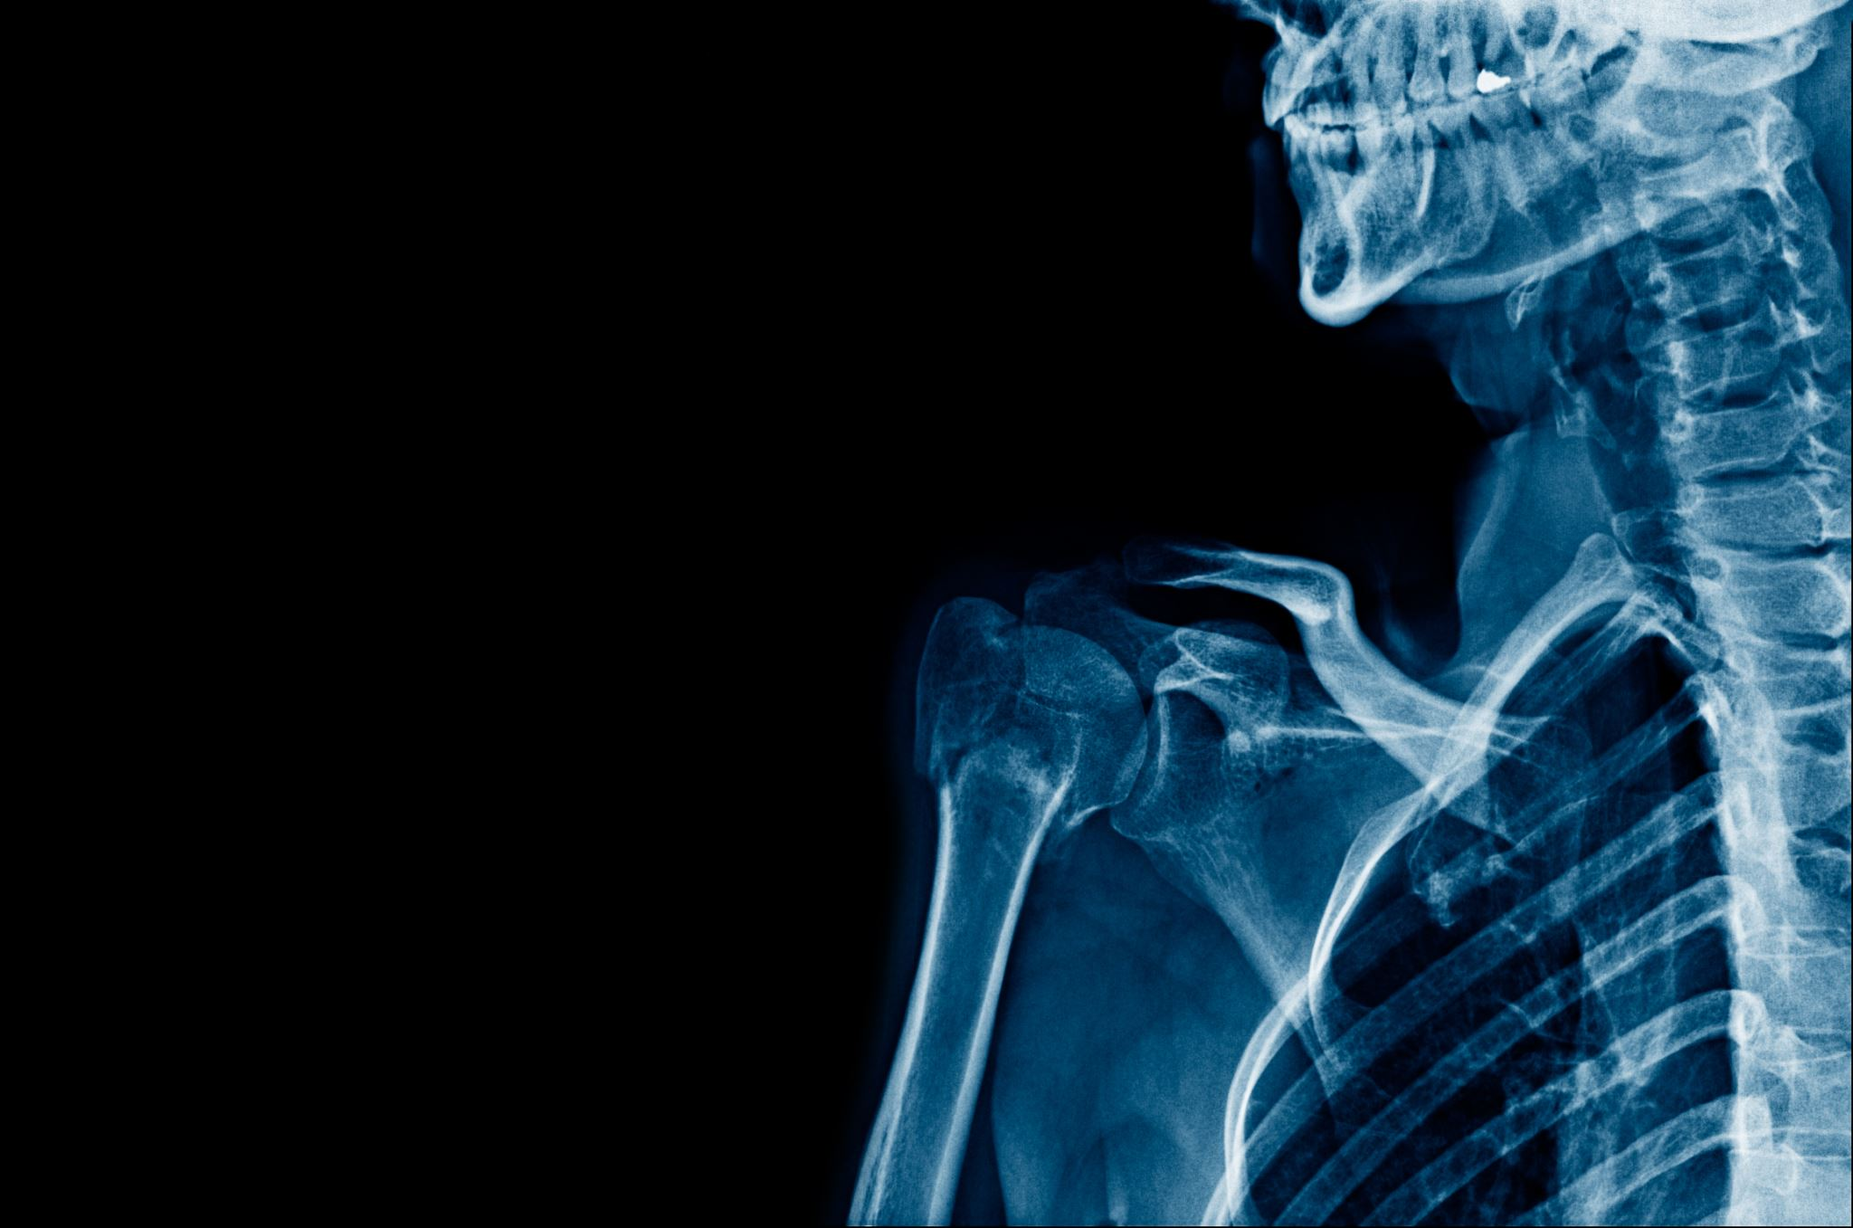
Pneumonia-Detection-from-Chest-X-Ray-Images
SMRUTIMAYEE SAHOO | 2201020020
GAYATRI MOHANTY | 2201020326
PREM KESHARI SAHOO | 2201020638
ANUJ AGRAWAL | 2201020018
SUNDEEP NAYAK | 2201020679
INDRANEEL MAHAPATRA | 2201020822

Slide 2
INTRODUCTION
Pneumonia is a serious lung infection that can be detected using chest X-ray images. This project uses a Convolutional Neural Network (CNN) to automatically classify chest X-rays into 'PNEUMONIA' and 'NORMAL' categories. The goal is to provide a fast and reliable diagnostic tool to assist medical professionals, especially in areas with limited access to radiologists.

Slide 3
Methodology
Data Collection: Chest X-ray images labeled as 'PNEUMONIA' and 'NORMAL' were sourced from public datasets.
Preprocessing: Images were resized, normalized, and augmented to improve model robustness.
Model Building: A CNN model was designed with layers for feature extraction and classification.
Training: The model was trained using the Adam optimizer and binary cross-entropy loss.
Evaluation: The trained model was tested on unseen data and evaluated using standard metrics.
Analysis: Misclassified images were reviewed to understand and improve model performance.

Slide 4
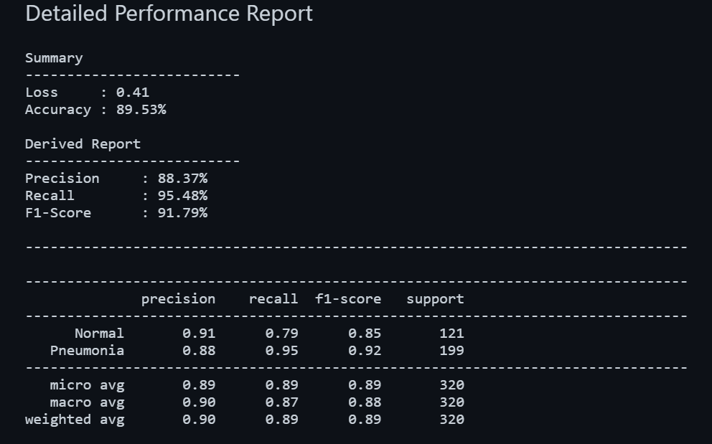
RESULTS
Derived Report
------------------------------------------------------------------------------------------
Precision : 88.37%
Recall : 95.48%
F1-Score : 91.79%
--------------------------

Slide 5
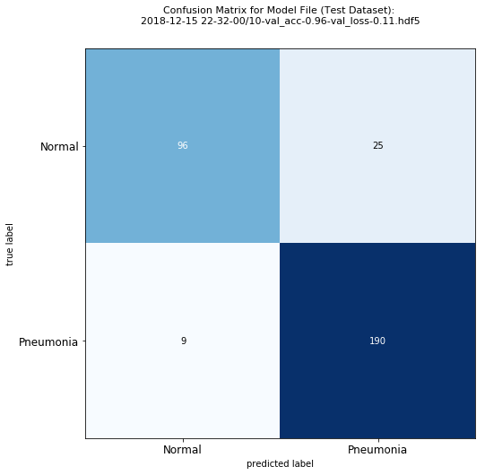
Truerue Positives (TP): 190 → Model predicted 1 and actual was 1.
Negatives (TN): 96 → Model predicted 0 and actual was 0.
False Positives (FP): 25 → Model predicted 1 but actual was 0.
False Negatives (FN): 9 T→ Model predicted 0 but actual was 1.

Slide 6
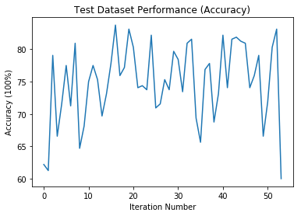
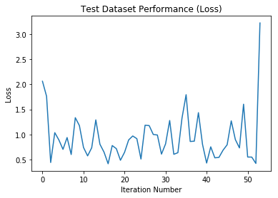
cc

Slide 7
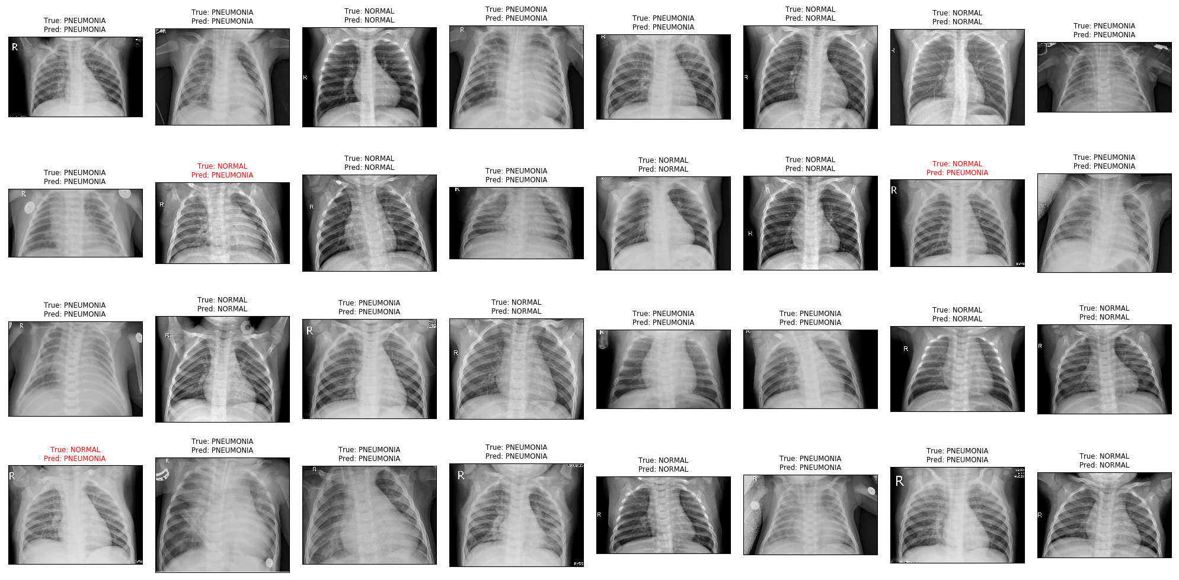
RESULT VISUALIZATION

Slide 8
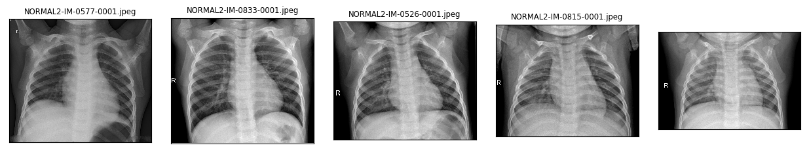
PREPROCESSING – SAMPLE IMAGE

Slide 9
Future Work
Incorporate
Incorporate transfer learning with architectures like ResNet50 or DenseNet.
Apply
Apply Grad-CAM for interpretability and model trust.
Use
Use more diverse and balanced datasets for better generalization.

Slide 10
CONCLUSION This project demonstrates the effectiveness of Convolutional Neural Networks (CNNs) in detecting pneumonia from chest X-ray images. By automating the classification process into 'PNEUMONIA' and 'NORMAL' categories, it provides a valuable diagnostic aid that can support healthcare professionals—particularly in underserved areas. The model aims to enhance early detection, reduce diagnosis time, and contribute to more accessible medical care

Slide 11
Thank you

